Slide 1
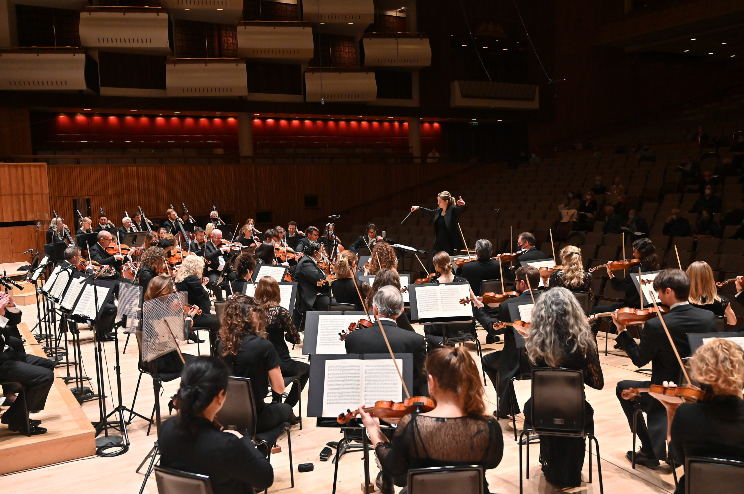
GCSE BrightSparks
Resources
BrightSparks is generously funded by the Rothschild Foundation with additional support from the Candide Trust, Dunard Fund, Rivers Foundation, The R K Charitable Trust, Mr & Mrs Philip Kan, Gill and Julian Simmonds
© Rachel Leach and the London Philharmonic Orchestra 2022

Slide 2
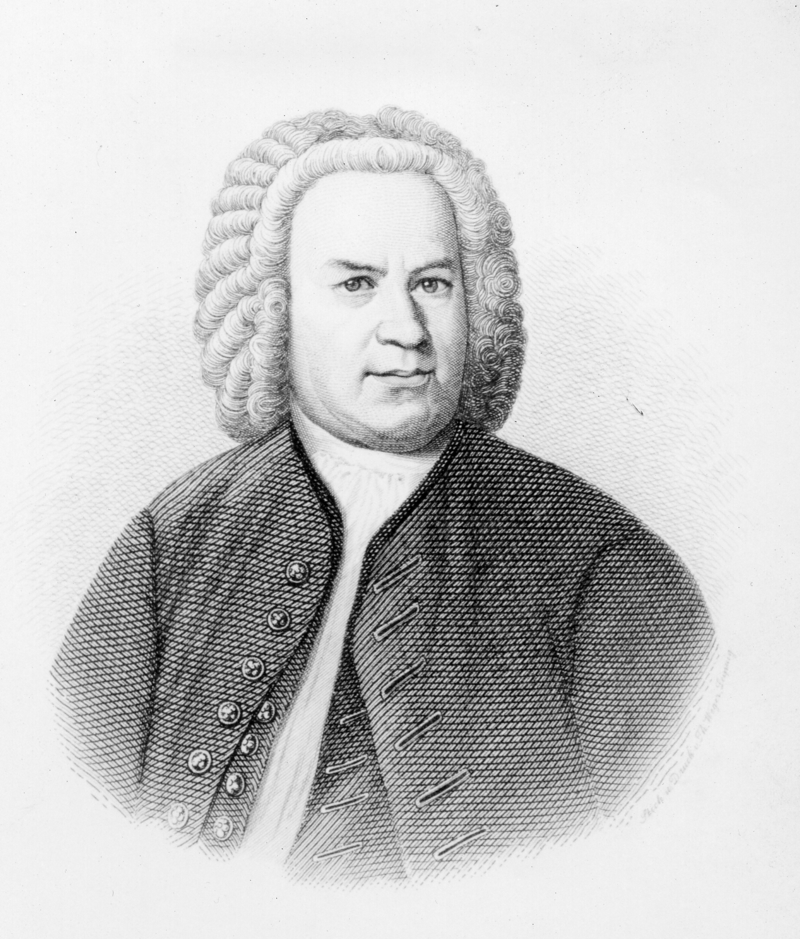
Johann Sebastian
Bach
(1685–1750)
‘Badinerie’
Orchestral Suite
No. 2
(1738)

Slide 3
Johann Sebastian
Bach
(1685–1750)
German Baroque composer
Regarded as one of the best composers that ever lived
‘Badinerie’ performed by flute, string orchestra and harpsichord continuo

Slide 4
J.S. Bach – Badinerie – 1738
Continuo = improvised accompaniment of chords/harmony over bassline, played by harpsichord.
A good indication that we are in the Baroque period.

Slide 5
J.S. Bach – Badinerie – 1738
Concerto = piece for soloist and orchestra
Baroque Period
Two types of concerto:
Solo concerto = one soloist and orchestra
Concerto grosso = small group of soloists (concertino) and accompanying group (ripieno)
Remember! – Although the flute plays a significant role in this piece, it is not a concerto!

Slide 6
J.S. Bach – Badinerie – 1738
Written for flute, string orchestra and harpsichord
This is the second movement from a seven-movement suite
Orchestral Suite = collection of small pieces in different dance styles
Badinerie = fun, light-hearted lively (means ‘banter’)

Slide 7
J.S. Bach – Badinerie – 1738
Written for flute, string orchestra and harpsichord
2/4 time signature
Allegro (fast)
Binary form (AA BB) – like many Baroque pieces

Slide 8
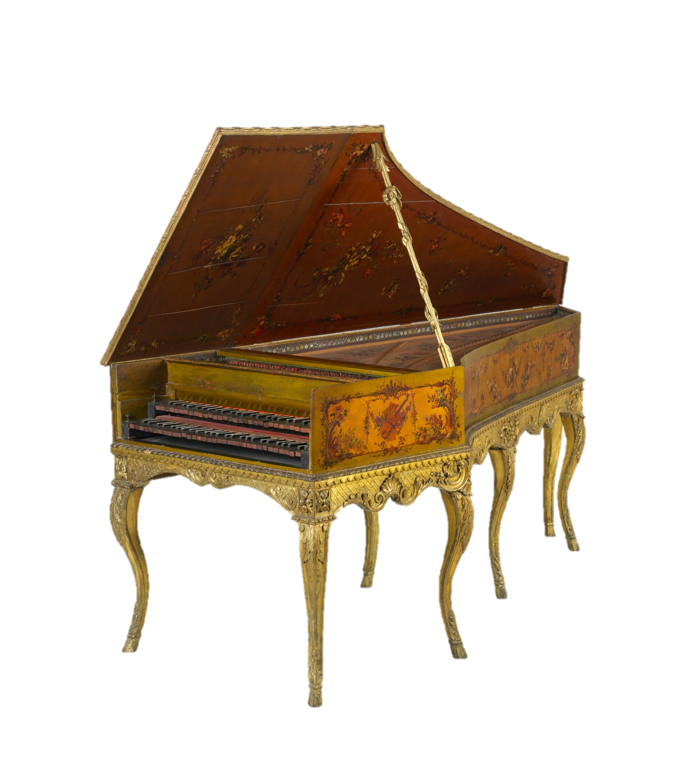
J.S. Bach – Badinerie – 1738
Analysis

Slide 9
J.S. Bach – Badinerie – 1738
Music is built from two melodic motifs: X and Y

Slide 10
J.S. Bach – Badinerie – 1738
Two melodic motifs (short melodic cell):
Motif X:
Falling arpeggio (notes of chord played separately)
B minor (home key)
Quavers and semiquavers – bouncy feel
Played by the flute at the beginning

Slide 11
J.S. Bach – Badinerie – 1738
Two melodic motifs:
Motif Y:
Smoother rhythm (more semiquavers)
Played by the flute at the beginning
Ends with a perfect cadence
Perfect cadence = final two chords of a phrase are V-I, giving sense of resolve/completion

Slide 12
J.S. Bach – Badinerie – 1738
The flute and the first violin move to a new melody…
Ornamentation =
Key element of the Baroque period
Trills, grace notes etc.
Little ‘twiddles’ that decorate the melody

Slide 13
J.S. Bach – Badinerie – 1738
This new melody is a sequence. We hear it twice, with the second time beginning on higher pitch.
The first violin also uses syncopation.
Syncopation =
Emphasis on the weaker parts of the bar

Slide 14
J.S. Bach – Badinerie – 1738
Binary Form
AABB

Slide 15
J.S. Bach – Badinerie – 1738
BINARY FORM: AA BB
Section A (Bars 1-16)
Begins in home key of B minor
Modulates and end in dominant minor key F# minor with perfect cadence (V-V7-I)
Section A repeats in full
Modulate = move key

Slide 16
J.S. Bach – Badinerie – 1738
BINARY FORM: AA BB
Section B (Bars 16 – end)
Begins in dominant minor key F# minor
Modulates and end in home key of B minor
Section A repeats in full
Key scheme is opposite of what happens in Section A

Slide 17
J.S. Bach – Badinerie – 1738
Section B:
Bach uses motif X to move through different keys
At the start of Section B the flute plays X to establish the new key of F# minor
Then the cello takes over and uses X to move to the next key of E minor

Slide 18
J.S. Bach – Badinerie – 1738
Section B:
Bach uses Motif Y to move through different keys
It is used to modulate via G major to D, the relative major of the home key

Slide 19
J.S. Bach – Badinerie – 1738
Section B:
Bach uses X and Y to move through different keys
Bar 28 – sequence (same as Section A but transposed) with ornaments and syncopation
Bar 33 – X and Y modified, featuring an appoggiatura and demisemiquavers
Ends with perfect cadence in B minor

Slide 20
J.S. Bach – Badinerie – 1738
Structure
summary

Slide 21
J.S. Bach – Badinerie – 1738
BINARY FORM: AA BB
Section A (beginning to bar 16):
Motif X on flute establishes the home key of B minor
Motif Y
Motif X repeats
Flute and violin play the melody, cello has X
Y used to modulate to dominant minor key
Perfect cadence in F# minor
Section A repeats

Slide 22
J.S. Bach – Badinerie – 1738
Section B (bar 16 to end):
Begins in F# minor. Motif X on flute establishes the key
Motif X passed between flute and cello, moving through keys
Motif Y on flute used to modulate to relative major (D)
Flute and violin play the melody, cello has motif X
Motif X and Motif Y modified and used to modulate back to home/tonic key (B minor)
Perfect cadence in home key, cello has Motif X

Slide 23
J.S. Bach – Badinerie – 1738
Section B repeats
Final perfect cadence in home key
Ornament/suspension on flute

Slide 24
For more information about concerts, education projects, resources and recordings, visit
lpo.org.uk
BrightSparks is generously funded by the Rothschild Foundation with additional support from the Candide Trust, Dunard Fund, Rivers Foundation, The R K Charitable Trust, Mr & Mrs Philip Kan, Gill and Julian Simmonds
© Rachel Leach and the London Philharmonic Orchestra 2022

